Slide 1
Fake News Detection
Comparative Study: Classical ML vs. Deep Sequential LSTM

Slide 2
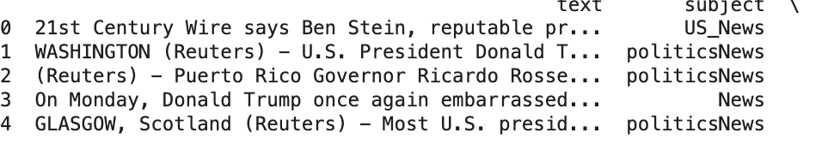
01. Dataset & Preprocessing
ISOT Fake News Corpus
Pipeline Operations
•
Volume: 44,898 structured news articles.
•
Feature union: Concatenating title and text streams.
•
Target: Balanced binary classification (0: Fake, 1: True).
•
Text cleaning: Universal lowercase conversion and complete punctuation/special symbol dropping.
•
Lengths: Right-skewed distribution (dense at 200–1000 words).
•
Validation split: Clean 70% Train / 15% Val / 15% Test partition.

Slide 3
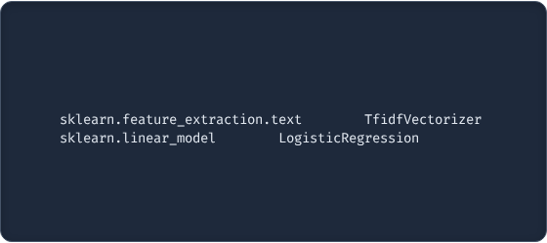
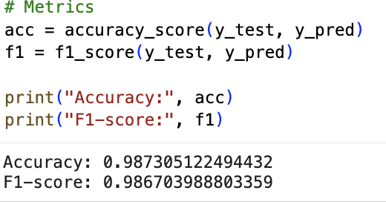
02. Baseline: TF-IDF + Logistic Regression
Statistical Feature Extraction
Maps global vocabulary token distribution while automatically penalizing generic structural stop-words.
Classifier: L2-regularized Logistic Regression to handle high-dimensional sparse vector spaces without overfitting.
Result: Outstanding 98.73% Accuracy achieved instantly.

Slide 4
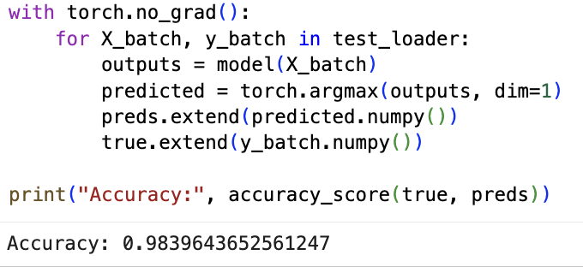
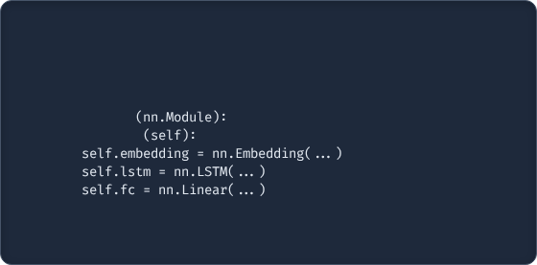
03. Deep Learning: LSTM Network
Recurrent Architecture
[ PASTE YOUR PYTORCH LSTM CLASS HERE ]
Processes incoming texts as integer token chains rather than static frequency grids.
# Вставь сюда архитектуру своей нейросети:
Pipeline: Standardized padding/truncating → Dense Embedding vector space → LSTM sequence matrix → Sigmoid logit head.
class
LSTMModel
def
__init__
Loss/Optimizer: Trained via PyTorch with BCELoss and Adam Optimizer.

Slide 5
04. Results & The Paradox Analysis
Logistic Regression
LSTM Model
The "Reuters" Artifact (Error Analysis): 99% of True news articles begin with a source marker: "WASHINGTON (Reuters) - ...". TF-IDF gives this token immense statistical weight, allowing the linear baseline to instantly separate classes. Conversely, LSTM processes texts sequentially; long articles induce subtle vanishing gradients and structural noise, making the heavy neural model slightly lose to simple frequency checking.

